Slide 1

Extraction of text & phone numbers from an image
Batch No: A-10 Project Guide:
LAKSHMI NARAYANA REDDY P (174G1A0531) Mr. LINGAM SUMAN M.Tech ,(Ph.D)
PRATHYUSHA P (174G1A0553) Assistant Professor
AKSHITHA P (174G1A0506)
NOAH K (184G5A0504)
Srinivasa Ramanujan Institute of Technology
Department of Computer Science & Engineering

Slide 2
Git hub Link:
https://github.com/AKSHITHA18/CSE_SRIT_A10/blob/main/app.py

Slide 3
Contents:
Introduction
Abstract
Problem Statement
Module description
Outputs
Conclusion
References

Slide 4
Introduction:
OCR stands for "Optical Character Recognition.” It is a technology that recognizes text within a digital image. It is commonly used to recognize text in scanned documents and images.
OCR is a set of computer vision tasks that convert scanned documents and images into machine readable text. It takes images of documents, invoices and receipts, finds text in it and converts it into a format that machines can better process. You want to read information off of ID cards or read numbers on a bank cheque, OCR is what will drive your software.

Slide 5
Existing system:
In the running world, there is a growing demand for the users to convert the printed documents in to electronic documents for maintaining the security of their data.
Hence the basic OCR the system was invented to convert the data available on papers into computer processable documents, So that the documents can be editable and reusable.
Proposed system:
Our proposed system is OCR that recognizes the phone numbers and also suggest information contains in an image.

Slide 6
Abstract:
Optical Character Recognition is the process of extracting text from an image. Character recognition is achieved through segmentation, feature extraction, and classification. The motive of OCR is to get text from existing images or text files. Generally, an image contains text, digits, phone numbers, mail ids, etc. Our main objective here is to extract phone numbers from an image. The shape of phone numbers in an existing image is unconstrained. Noting down phone numbers from a highly texted image is a challenging thing.
To resolve this, our project provides an application, where it reads an image and extracts out the phone numbers. It also shows information about the image and provides a facility to speak out and copy the phone numbers. This can also reduce the time and makes these types of routine things faster. Overall, we conclude that commodities are becoming even smarter, which leads to reducing human effort and time. Well, our project is one of those types.
Keywords: OCR, Character Recognition, Flask, Image Recognition, Open CV, Text-to-speech, Pre-Processing.

Slide 7
Problem statement:
Noting any data from an image is risky and that too if that image has noisy data, it’s a challenging thing. Our main objective is, focusing on phone numbers and related text about the image. an image may contain multiple phone numbers. It takes much time to extract each phone number from an image.

Slide 8
Modules description:
EasyOCR:
EasyOCR is a python package that allows the image to be converted to text. It is by far the easiest way to implement OCR and has access to over 70+ languages including English, Chinese, Japanese, Korean, Hindi, many more are being added.
Pyttsx3:
pyttsx3 is a text-to-speech conversion library in Python. Unlike alternative libraries, it works offline, and is compatible with both Python 2 and 3.

Slide 9
Opencv:
OpenCV is a huge open-source library for computer vision, machine learning, and image processing. OpenCV supports a wide variety of programming languages like Python, C++, Java, etc. It can process images and videos to identify objects, faces, or even the handwriting of a human. When it is integrated with various libraries, such as Numpy which is a highly optimized library for numerical operations, then the number of weapons increases in your Arsenal i.e whatever operations one can do in Numpy can be combined with OpenCV.

Slide 10
Pyenchant:
Enchant is used to check the spelling of words and suggest corrections for words that are miss-spelled. It can use many popular spellchecking packages to perform this task, including ispell, aspell and MySpell. It is quite flexible at handling multiple dictionaries and multiple languages.
Flask:
Flask is a popular Python web framework, meaning it is a third-party Python library used for developing web applications. Web Application Framework or simply Web Framework represents a collection of libraries and modules that enables a web application developer to write applications without having to bother about low-level details such as protocols, thread management etc.

Slide 11
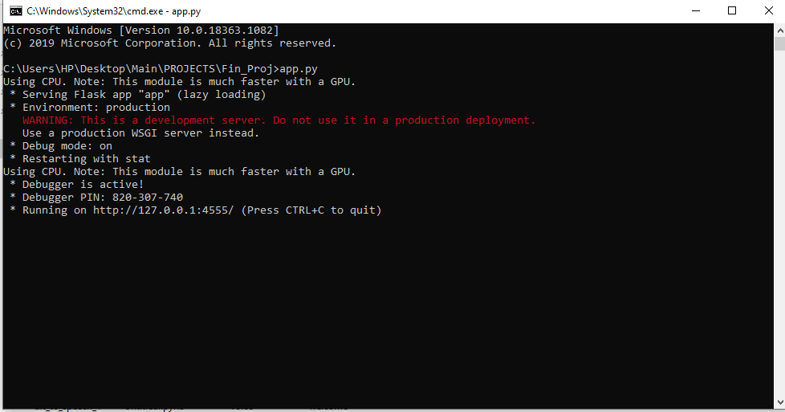
Output:
* Running the Application

Slide 12
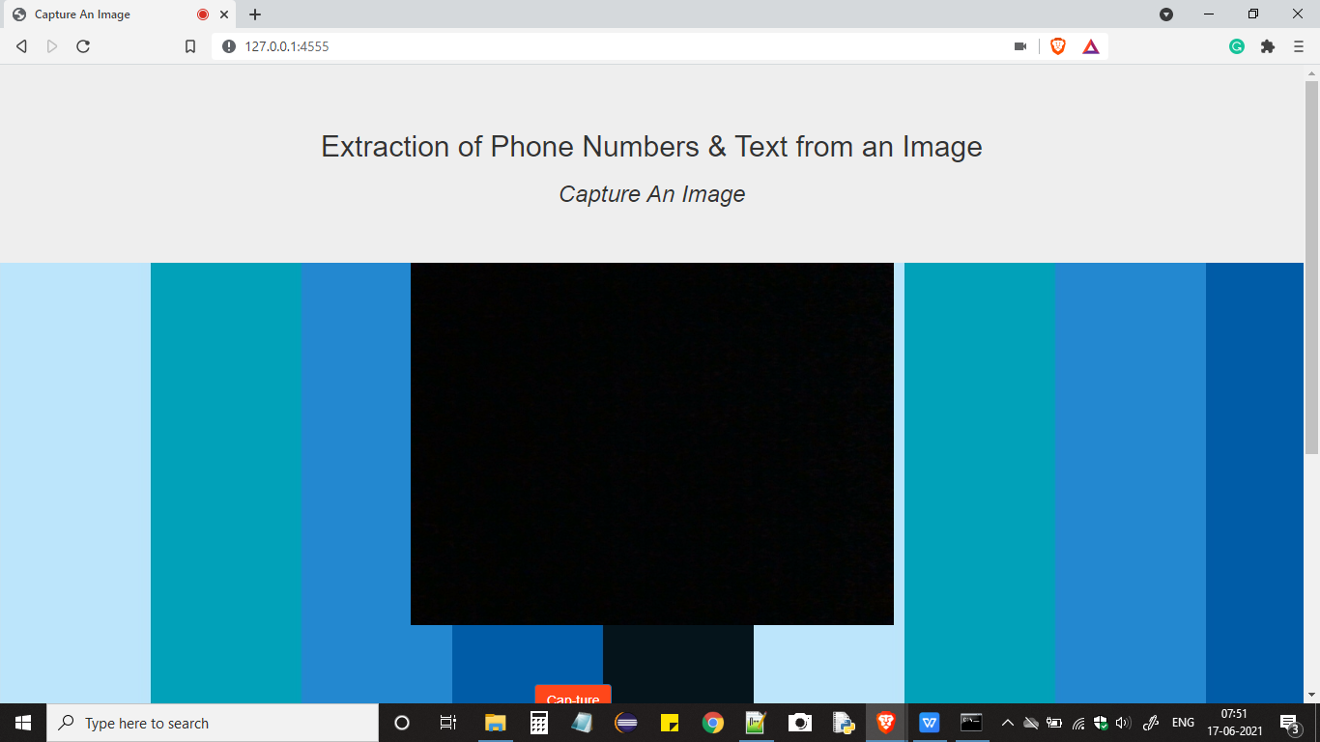
Index Page:

Slide 13
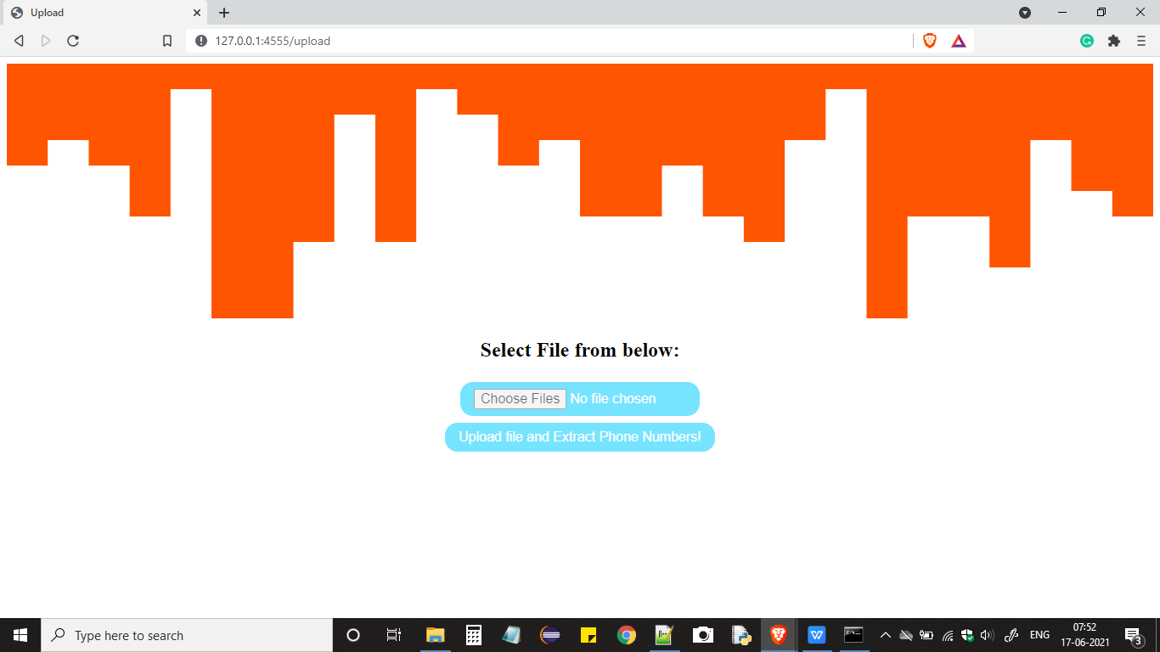
Uploading an Image:

Slide 14

Sample Image:

Slide 15
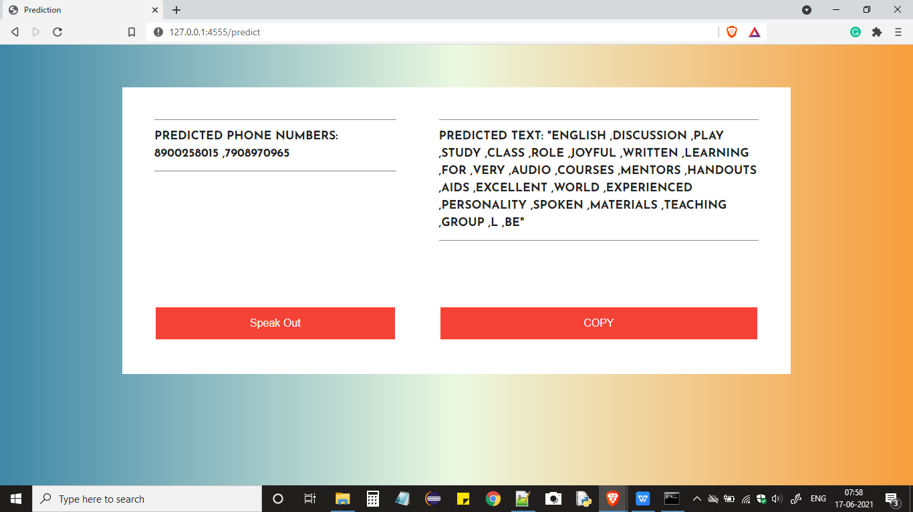
Extracted Phone Numbers and Text:

Slide 16
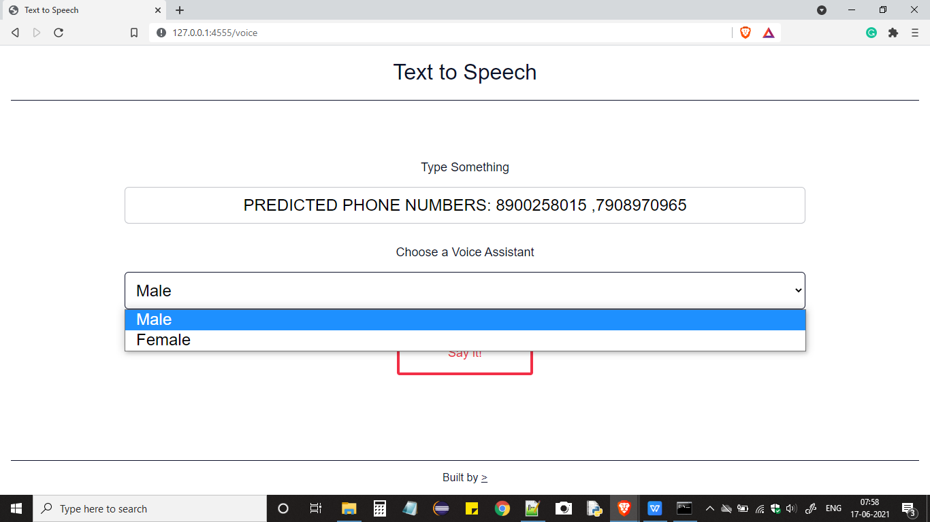
Text to Speech:

Slide 17
Conclusion:
we use the OCR in the project and developed an application to extract phone number from an image. The input will be given by the user then the OCR processed it then it will given phone numbers and the main keywords of an image as an output. This application is helpful when we have more phone numbers in an image and it also extracts if it is in the different angles.

Slide 18
References:
[1] Identification of Optimal Optical Character Recognition (OCR) Engine for Proposed System: Authors-Mrunal G. Marne, Pravin Futane, Sakshi B. Kolekar, Aditya D. Lakhadive, Snehwardhan K. Marathe, 25 April 2019
[2] Handwritten Optical Character Recognition (OCR): A Comprehensive Systematic Literature Review (SLR), Authors - Jamshed Memon, Maira Sami, Rizwan Ahmed Khan, and Mueen Uddin 5 April 2019
[3] Optical Character Recognition: An illustrated guide to the frontier George Nagy, Thomas A. Nartker, Stephen V. Rice, 06 April 2015.

Slide 19
Any Queries
?

Slide 20
Thank you

